Slide 1
Impact of Demographic Factors on Perception of Tertiary Colors A two – way ANOVA analysis
Amro Issam Issa Alshaban

Slide 2
Introduction
Understanding the factors influencing color perception has been a subject of interest in various studies, with age and gender our primary focus in this report.
Previous studies suggested that females observe more shades of colors and utilize a greater color spectrum than males.
Other studies concluded pronounced differences due to varying age.
In view of these insights, we decided to test for the presence of statistical disparity in color perception across different genders and age groups by examining differences in the mean number of different tertiary colors correctly reported in a provided painting.

Slide 3
Methodology
Female |  | Male
Younger | Older | Younger | Older
6 | 4 | 2 | 8
11 | 4 | 7 | 1
11 | 4 | 2 | 1
11 | 5 | 3 | 2
11 | 5 | 3 | 2
11 | 5 | 3 | 2
11 | 5 | 3 | 2
10 | 6 | 4 | 3
10 | 6 | 4 | 3
10 | 6 | 4 | 3
10 | 6 | 4 | 3
9 | 6 | 4 | 3
10 | 7 | 2 | 4
9 | 5 | 5 | 4
9 | 7 | 5 | 4
12 | 7 | 5 | 4
12 | 7 | 5 | 0
12 | 7 | 5 | 4
12 | 8 | 6 | 5
12 | 8 | 6 | 5
13 | 8 | 6 | 5
13 | 8 | 6 | 5
15 | 8 | 6 | 5
13 | 9 | 7 | 6
14 | 9 | 7 | 6
14 | 9 | 7 | 6
17 | 9 | 7 | 6
7 | 10 | 8 | 7
7 | 11 | 8 | 7
7 | 10 | 10 | 6
A sample of 120 individuals was gathered, distributed into 4 equal sized groups categorized by age (older/younger) and gender (male/female).
A summary statistics of the data is provided, and results are interpreted.
Visualization of data is performed via boxplots and interaction plots.
Upon inspection of summary statistics, normality and equal variances tests are performed.
Outlier analysis is performed to identify extreme values in the data.
Under appropriate conditions established by previous tests, a balanced two – way ANOVA is conducted to explore effects of age and gender on perception of tertiary colors. Results are interpreted accordingly.
Ad – hoc tests will be employed if the ANOVA provides significant results.
All tests are subject to a 5% significance level.

Slide 4
Summary statistics
Gender | Age | Sample Size | Mean | SE Mean | Standard Deviation | Minimum | Q1 | Median | Q3 | Maximum | IQR | Skewness | Kurtosis (excess)
Female | Older | 30 | 6.967 | 0.351 | 1.921 | 4.000 | 5.000 | 7.000 | 8.250 | 11.000 | 3.250 | 0.21 | -0.78
 | Younger | 30 | 10.967 | 0.451 | 2.470 | 6.000 | 9.750 | 11.000 | 12.250 | 17.000 | 2.500 | 0.09 | 0.33
Male | Older | 30 | 4.067 | 0.362 | 1.982 | 0.000 | 2.750 | 4.000 | 6.000 | 8.000 | 3.250 | -0.07 | -0.61
 | Younger | 30 | 5.133 | 0.364 | 1.995 | 2.000 | 3.750 | 5.000 | 7.000 | 11.000 | 3.250 | 0.28 | -0.29
Key Insights
Data Symmetry and possible Normality
Differences in Age alter the effects of Gender
Consistent Variability among all Groups
Mean and Median are nearly equal per group.
Skewness and (excess) Kurtosis are close to zero per group, suggesting symmetry and almost normal tails, respectively.
For younger individuals, mean differences between genders is nearly twice that of older individuals.
For females, mean differences between age groups is nearly four times that of males.
All groups have nearly the same standard deviation.
All groups have nearly the same interquartile range (IQR).

Slide 5
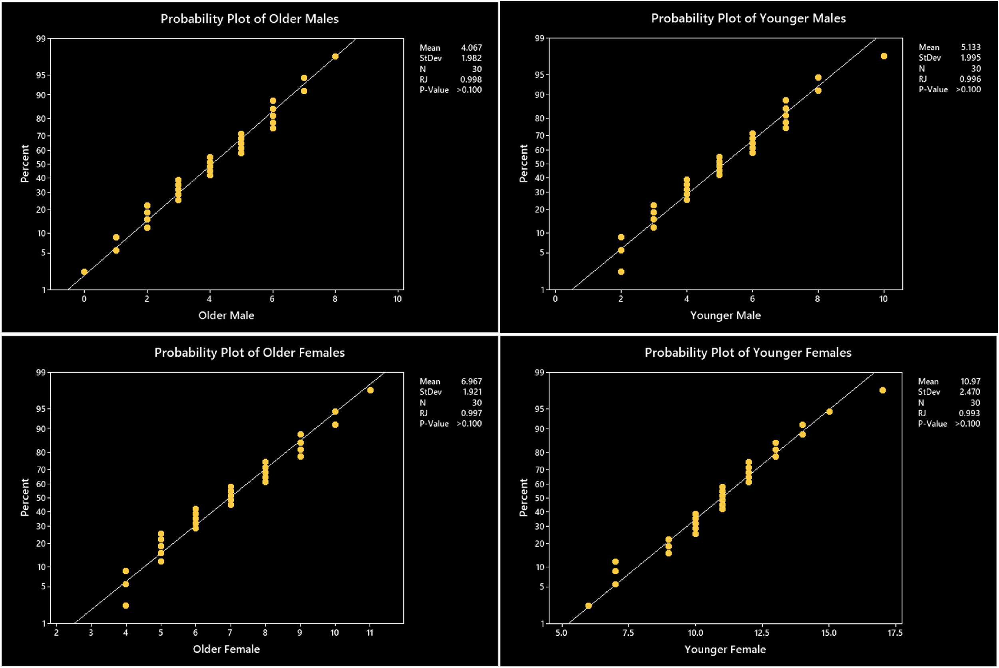
Normality Test
Motivated by observations of summary statistics and wanting to perform a valid ANOVA, a normality test is carried.
A Ryan – Joiner test was applied to test the normality of every group.
Results are shown in four different panels accompanied by probability plots per group.
Test results are concluded via p – value comparisons.
Results: p – values > 0.1 indicating no statistical evidence against normality, aligning with our observations.

Slide 6
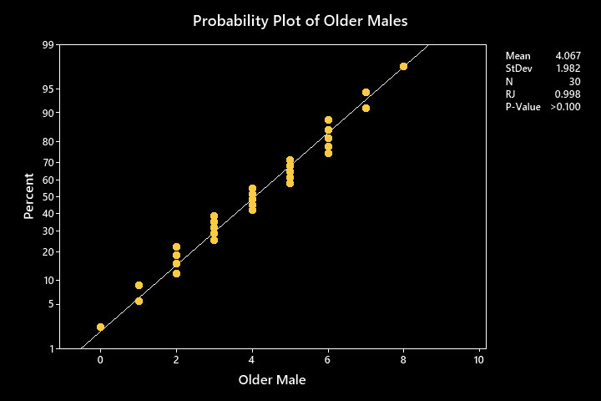
Normality Test (Older Males)

Slide 7
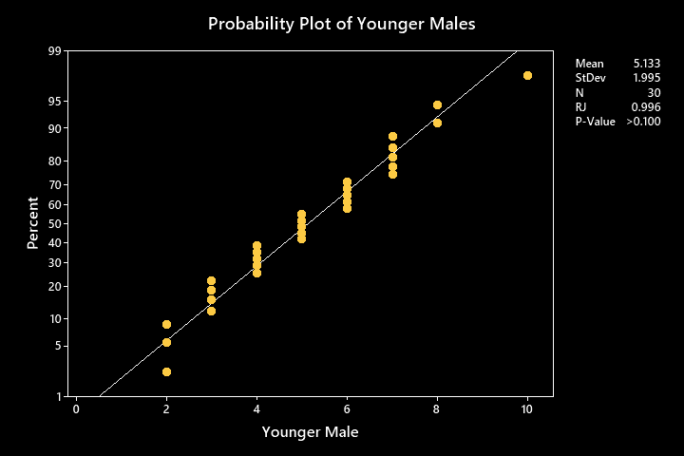
Normality Test (Younger Males)

Slide 8
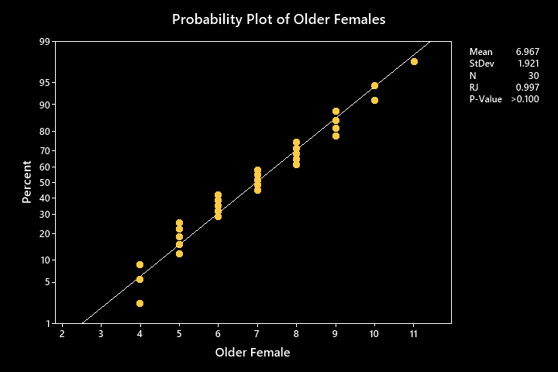
Normality Test (Older Females)

Slide 9
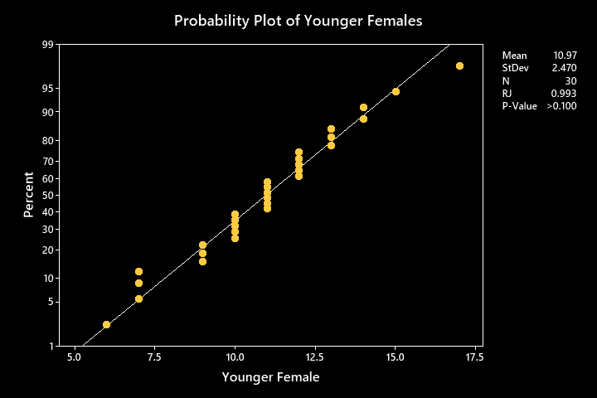
Normality Test (Younger Females)

Slide 10
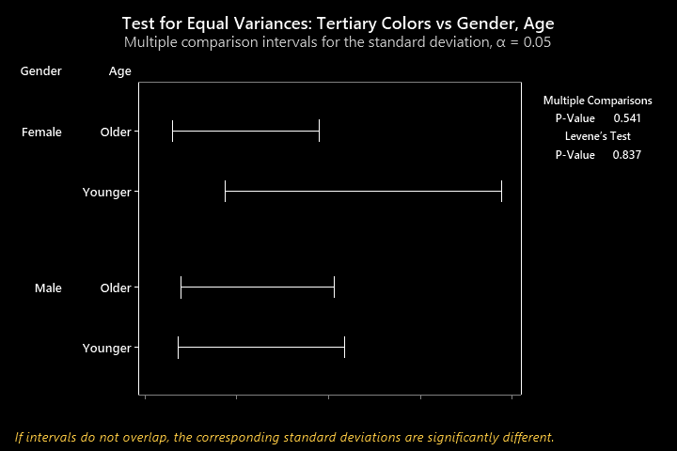
Equal Variances Test
Method
Null Hypothesis | All variances are equal
Alternative Hypothesis | At least one variance is different
Multiple Comparisons and Levene tests were carried
Results are shown on the right, accompanied by a 95% Bonferroni Confidence Intervals plot of standard deviations
Test results are concluded via p – value comparisons.
Results: p – values for both tests exceed the significance level, indicating no statistical evidence against equality of variances, aligning our observations.
Tests
Method | Test statistic | p – value
Multiple Comparisons | ____ | 0.541
Levene | 0.28 | 0.837
Gender | Age | StDev | CI
Female | Older | 1.92055 | (1.50769, 2.66864)
Female | Younger | 2.47028 | (1.77547, 3.74915)
Male | Older | 1.98152 | (1.53496, 2.79031)
Male | Younger | 1.99540 | (1.49913, 2.89715)

Slide 11
Bonferroni Confidence Intervals plot of StDevs

Slide 12
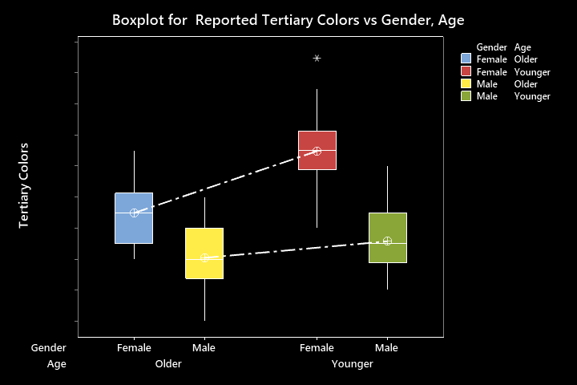
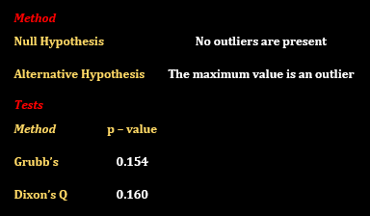
Exploring Gender – Age Interaction and Outlier Analysis
From our boxplot, we observe:
Younger people reported more tertiary colors than older people in both genders.
Females reported more tertiary colors than males in both age groups.
Unparallel mean connecting lines suggests the possible presence of an interaction between the factors (difference between males and females in younger people differs from that of older people).
The maximum value in the younger females' group may be an outlier. Under the normality assumption, we use Grubb’s test and Dixon’s Q test to check whether this maximum is an outlier.
Results: p – values for both tests exceed the significance level, indicating no statistical evidence that the maximum is an outlier. We will adopt this result in our analysis.

Slide 13
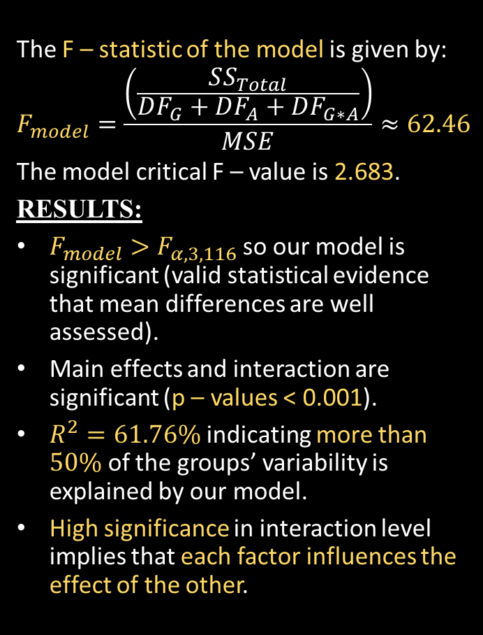
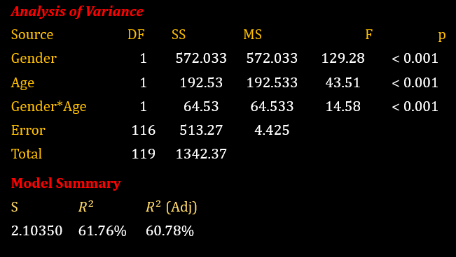
Balanced Two – Way ANOVA
Under the normality, equal variances and no – outlier assumptions, we perform a Balanced Two – Way ANOVA. Results are shown below.

Slide 14
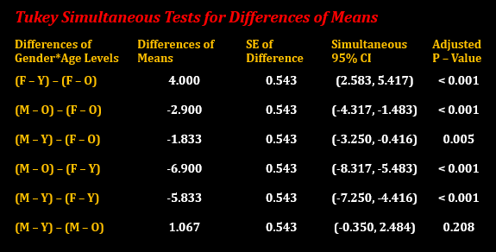
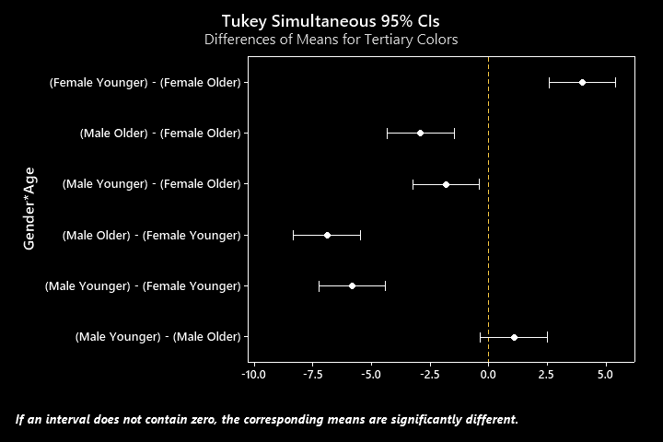
Tukey Pairwise Comparison Test
Since the interaction is significant, we perform a Tukey Pairwise Comparison Test on the interaction to see which factor pairs contribute significantly to the observed interaction.
Results: all group differences are significant except for the mean difference between younger and older males (all p – values are less than the significance level except the younger and older males p – value).

Slide 15
Conclusions
Gender and Age impact the number of perceived tertiary colors by individuals.
For each age group, females tend to perceive more tertiary colors than males.
For each gender group, younger individuals perceive more tertiary colors than older individuals.
Gender alters the effect age has on an individual’s ability to perceive tertiary colors (and vice versa).
Gender effects are more pronounced in younger individuals than older individuals.
Effect of age is significant in females, whereas males show no significant difference.

